Slide 1
Basic Introduction to Linux
Anthony J Souza

Slide 2
Contents
Introduction
History
Basic Blocks of Linux Kernel
Distribution Zoo
Linux File System – Important Directories
Useful Linux Commands
Basic Shell Scripting

Slide 3
Introduction
The Linux kernel is an open-source operating system.
A Unix-like monolithic kernel.
Do not confuse the Linux kernel with Linux distributions.
At its lowest form, a Linux Kernel is a piece of software to manage a computers hardware.
This include user management, resource management , process scheduling, hardware drivers, and so on.
A Linux operating system in its minimalist form can simply be a Linux kernel, C Libraries, toolchain, and basic system utilities
System utilities include a shell and a login process to name a couple.

Slide 4
Introduction
A Linux distribution adds to the previous a:
Windowing system
Package management
Other software picked by the maintainer of a given distribution.
Some examples are:
Arch
Ubuntu
RedHat
These are all Linux Distribution with a certain goal in mind.
Not all distributions are the same but generally are built from same Linux kernel with minor modifications.

Slide 5
History
Before there was Linux there was Unix
Before that there was Multics.
Multiuser operating system project developed by Bell Labs which in the end failed.
This led to a filesystem design in 1969 which eventually led to Unix.
While testing this design, it was implemented on a computer called PDP-7 in 1969.
In 1971, Unix was later implemented on PDP-11
In 1973, something that is rarely done, Unix was rewritten in C.
This is no simple task.

Slide 6
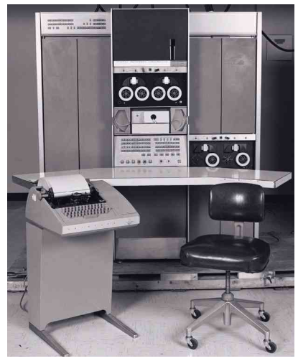
History – PDP-7

Slide 7
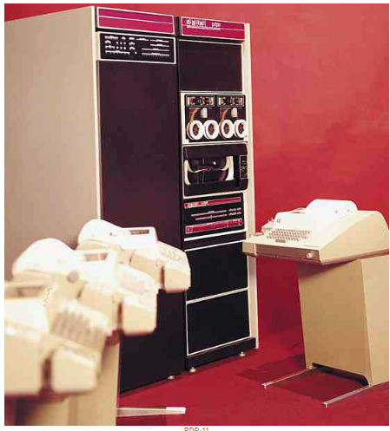
History – PDP-11

Slide 8
History
Unix, Sixth Edition was the first Unix used outside of Bell Laboratories.
Also known as V6
Given Unix’s simplistic design and the OS was distributed with source code as well led to further development at external organizations
Most notable is Berkeley’s Software Division (BSD).
Berkeley release several versions adding new and important features along the way.

Slide 9
History
BSD Versions:
1BSD – 1977
2BSD – 1978
Added csh and vi as well as other packages and patches
3BSD – 1979
First standalone version
Add Virtual memory
Various Versions of 4BSD were released, with final version being released in 1994
Added demand paging, job control and TCP/IP.

Slide 10
History
Then in 1991, a student at the University of Helsinki by the name of Linus Torvalds implemented the first version of the Linux Kernel.
It was to run on Intel’s 80386 micro-processor.
Currently MS-DOS was the reigning PC at the time, but Linus did not have must use for this OS.
Other Unix based operating systems were powerful BUT not free.
Minix was a low-cost Unix system used as a teaching aid, but it was difficult to make changes to its source code.
Mostly due to licensing.

Slide 11
History
Linux gained many users in the beginning.
Due to Linux’s licensing, it attracted a lot of developers.
These developers began hacking away at the kernel adding new features, improving code.
Eventually Linux shifted from a simple project to a large collaborative project in little time.
This also led to the implementation of git. Linus felt current VCS were inadequate for maintaining Linux source code.
Windows recently started using git to maintain Window’s source code and git was also inadequate.
Windows made a lot of improvements to git to get it work for the windows source tree.

Slide 12
History
Today the Linux kernel is a full-fledged operating system that can run on many types of hardware.
Hardware varying from fridges to ocean buoys to larger warehouse size super computers.
Currently the top 10 super computers in the world run a Linux kernel with varying distributions.
Frontier being the current leader.
Oak Ridge Labs in Tennessee.
8,730,112 total cores.
AMD EPYC 64C 2GHz processors
9.2 petabytes of memory (half HBM(High Bandwidth Memory, half DDR4).

Slide 13
Basic Blocks of Linux Kernel
At is core, Linux is simply a Kernel.
A kernel contains all the necessary pieces to maintain a computer’s hardware.
These include modules to manage memory, process scheduling, user management, virtual file system management, network management, security, hardware device drivers, and other small services provided by the kernel.
Then distribution maintainers build on top of this kernel to make distros like Debian, Ubuntu, Arch, Mint, and so on.

Slide 14
Distribution Zoo
Linux comes in several different versions known as distributions.
Linux distributions aren’t upgraded versions of each other, but rather different yet similar flavors of Linux.
Different distributions install different default bundles of software.
Linux distributions can be viewed here https://distrowatch.com/
Interesting picture showing “Distribution Lineage”
https://upload.wikimedia.org/wikipedia/commons/1/1b/Linux_Distribution_Timeline.svg

Slide 15
Linux Permissions
Like most Operating Systems, there are control systems put in place to control access to files and directories.
Linux permissions can be a complicated at first but in reality, it can be quite simple.
First, lets look at a command that can show permissions of a file or directory.
You can run : ls –l
Output is on the next slide

Slide 16
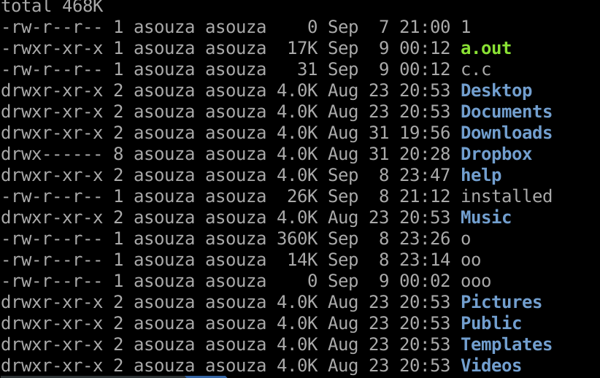
Linux Permissions

Slide 17
Linux Permissions
Permissions are broken down in 3 groups
User permissions
The Owner permissions apply only the owner of the file or directory, they will not impact the actions of other users.
Group permissions
The Group permissions apply only to the group that has been assigned to the file or directory, they will not affect the actions of other users.
Other user permissions.
The other permissions apply to all other users on the system, this is the permission group that you want to watch the most.

Slide 18
Linux Permissions
There are 3 basic permissions types:
Read
The Read permission refers to a user’s capability to read the contents of the file.
Write
The Write permissions refer to a user’s capability to write or modify a file or directory.
Execute
The Execute permission affects a user’s capability to execute a file or view the contents of a directory.

Slide 19
Linux Permissions
Taking two of those lines we can inspect the permissions of two of the entries:
drwxr-xr-x 2 asouza asouza 4.0K Aug 23 20:53 Pictures
-rw-r--r-- 1 asouza asouza 360K Sep 8 23:26 o
The first character in each entry is used to identify the entry type.
These can be either file (-), directory(d), or link(l).
The next 3 characters are for user permissions
The next 3 characters are for group permissions
The next 3 characters are for all users' permissions

Slide 20
Linux Permissions
Taking two of those lines we can inspect the permissions of two of the entries:
drwxr-xr-x 2 asouza asouza 4.0K Aug 23 20:53 Pictures
-rw-r--r-- 1 asouza asouza 360K Sep 8 23:26 o
The next value, is an integer whichs defines the number of hard-links to the file.
The next two entries define the file owner and group owner.
The next 3 values are size of the entry, timestamp when it was last accessed, and name.

Slide 21
Linux Permissions
Modifying these permissions can be done with chmod (discussed later).
Modifying the ownership of files can be done with chown (discussed later).
To define permissions, you will need to use the permissions groups and types.
There are 4 groups:
u – Owner
g – Group
o – Other
a – All users

Slide 22
Linux Permissions
There are 3 permissions types (as stated earlier):
r – Read
w – Write
x – Execute
Using minus ( - ) or plus ( + ) to remove or add certain permissions, respectively.
With the groups, types and operators combine we can explicitly define permissions.
For example, a-x would remove the execute permission from all groups (users, groups and other)

Slide 23
Linux Permissions
In the previous slides, we show a way to symbolically assign permissions.
You may also use binary references to set permissions as well.
When using binary references you will specify 3 numbers,
First number is user
Second number is group
Third number is other
Example : 777 is everyone has read, write, and execute permission
You may have seen this in a lot of web development blogs, this is the quick lazy way to fix permissions for files that can’t be read, but it is the least secure.

Slide 24
Linux Permissions
When deciding what values to use, keep the following in mind:
Read → 4
Write → 2
Execute → 1
With the above if you want a user to have read write execute permissions then its 4+2+1 = 7
If you have taken 256, you'll remember number representations:
Binary, decimal, hexadecimal and….. Octal
Octal isn’t taught as much but its what Linux uses to represent the permission bits.
Octal is simply a number representation with digits between 0 and 7.

Slide 25
Linux Permissions – Table of Octal Digits
Octal Digit | Binary Representation (rwx) | Permission
0 | 000 | none
1 | 001 | execute only
2 | 010 | write only
3 | 011 | write and execute
4 | 100 | read only
5 | 101 | read and execute
6 | 110 | read and write
7 | 111 | read, write, and execute (full permissions)

Slide 26
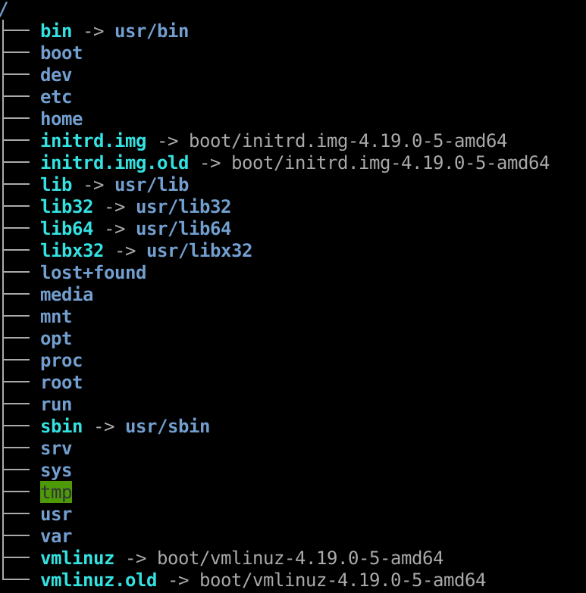
Linux File System

Slide 27
Linux File System – Important Directories
Linux has a file structure that adheres to the Filesystem Hierarchy Standard (FHS).
It defines the directory structure and directory contents in Unix-like operating systems.
It is maintained by the Linux Foundation.
In the next few slides we will discuss the Linux filesystem and important folders and files in Linux.
A nice command to view the Linux file system is the tree command this will need to be installed via : sudo apt –y install tree

Slide 28
Linux File System - /
At the top of the file structure is /.
This is the root directory of the Linux OS.
All folders extends from this root and are subfolders of this directory.
Permissions of this directory is set to only allow the root user to modify it.
/root is the home directory of the root user.

Slide 29
Linux File System - /boot
The boot directory stores the files related to booting the system.
These include:
Kernel Images
Kernel config files
Initrd images
Grub and its config files

Slide 30
Linux File System - /bin
This folder contains base executables which are required for minimal system working.
Commands which are available in /bin folder is accessed by everyone and can run by every user.
This folder contains basic commands such as cat, chmod, chgrp, chown, date, dir, dd, df, ln, mv, echo and zipping tools such as bzip, gzip etc.

Slide 31
Linux File System - /sbin
sbin stands for system binaries
This folder contains commands which are required for changing system properties or system level settings such as disk management, network management etc.
This folder is accessed sometimes by normal user, but they can not execute any of the commands located in this and what ever commands/scripts located in this folder are run only by root user
If you want to make normal user to run these commands, you must implement SUDO or Powerbroker to give elevated access.

Slide 32
Linux File System - /usr
Secondary hierarchy for read-only user data; contains the majority of (multi-)user utilities and applications.
Contains binaries, libraries, documentation, and source-code for second level programs
Has a few important subdirectories as well
/usr/bin contains binary files for user programs.
For example: at, awk, cc, less, scp
/usr/sbin contains binary files for system administrators.
For example: atd, cron, sshd, useradd, userdel
/usr/lib contains libraries for /usr/bin and /usr/sbin
/usr/local contains user programs that you install from source.
For example, when you install apache from source, it goes under /usr/local/apache2
/usr/src holds the Linux kernel sources, header-files and documentation.

Slide 33
Linux File System - /dev
Directory to store dev files.
These devices include terminals, usb, cd roms, HDD, mounted images and so on.
An interesting one is /dev/null
is a special filesystem object that throws away everything written into it
For example, you can redirect std out and std err to /dev/null to suppress all program output.
ls –la > /dev/null 2>&1 or simple ls –la &> /dev/null

Slide 34
Linux File System - /etc
etc stores all system-wide configuration files.
Generally restricted to configuration files and is not allowed to store binaries according the FHS.
Some of these system configuration files include:
For webservers : apache, nginx, etc
For apt (package manager)
Sudoers ( list of users who have sudo access)
Default values for bashrc (first values read is .bashrc in each user's home dir)
Passwd file – shows list of users and which groups they belong to.
Most entries in this directory has a man page entry they can be viewed with the following:
man 5 passwd

Slide 35
Linux File System - /home
Directory where all use specific files and folders are stored.
Generally, there is a folder for each user
Not required though

Slide 36
Linux File System - /lib
Library files are stored here
Libraries are files containing code that applications can use
There are other lib folders in other directories.
The one defined in root ( / ) also stores kernel modules as well.
These kernel modules help make your system work and run drivers like network drivers, video card drivers, printers, sound cards, even drivers for virtual box to run.

Slide 37
Linux File System - /media
directory is where external storage will be automatically mounted when you plug it in and try to access it.
Items like:
Cdroms
Usb
External SD, HHD/SSDs

Slide 38
Linux File System - /mnt
/mnt where you would manually mount storage devices or partitions.
Not a widely use directory anymore but it sometimes useful when fixing file system issues.
This directory is provided so that the system administrator may temporarily mount a filesystem as needed
But if storage devices are mounted on /mnt (via mount and umount) then these should only be temporary mounted devices.

Slide 39
Linux File System - /opt
reserved for the installation of add-on application software packages.
Thing of programs like intelij
Sometimes when installing Chrome on Linux, it will be stored here.
Your Vbox Guest Editions is installed here.

Slide 40
Linux File System - /srv
Stands for service
contains site-specific data which is served by this system.
main purpose of specifying this is so that users may find the location of the data files for a specific service
For example, if you are running a webserver you can host files under /srv/html or an ftp site can be /srv/ftp.

Slide 41
Linux File System - /var
The a /var directory is typically where files whose contents change during system operation are stored.
/var is specific for each computer; that is, it is not shared over a network with other computers.
Some important sub directories:
/var/log – System and application log files
/var/cache – contains cached data from application programs
/var/lock – contains lock files created by programs to indicate that they are using a file or device
/var/lob – contains dynamic data libraries and files

Slide 42
Linux File System - /tmp
tmp directory must be made available for programs that require temporary files.
Programs or services that require temporary files will store them in /tmp.
It is also recommended that files and directories located in /tmp be deleted whenever the system is booted.

Slide 43
Linux File System - /proc
Is a virtual (pseudo) filesystem.
providing process and kernel information as files
Generally automatically generated and populated by the system, on the fly.
A few system utils are programs that read from this directory, albeit in a better format.
For example:
lsmod → cat /proc/modules
More information can be read at : man 5 procfs

Slide 44
Linux File System - /sys
/sys is like proc in its idea. A virtual file system to help display system information.
Some files in /sys ( as well as proc) can be written to change system properties.
For example:
echo N > /sys/class/backlight/acpi_video0/brightness → would lower or raise the brightness of your monitor depending on the value of N.
More information can be read at : man 5 sysfs

Slide 45
Useful Linux Commands
One of the best ways to interact with the Linux OS is through its commands line tools.
In the next handful of slides, we will explore some of these commands.

Slide 46
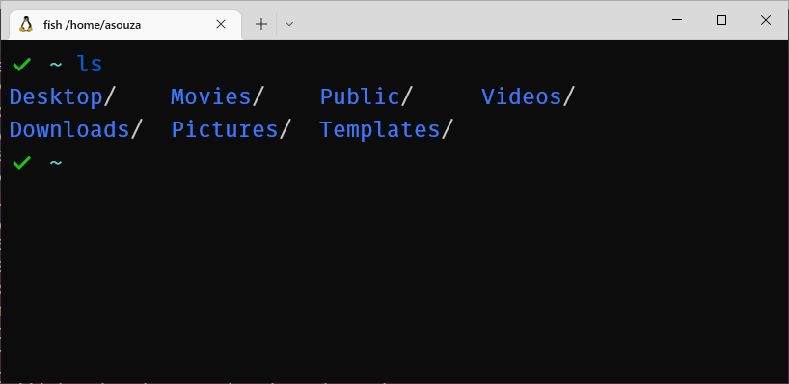
Linux Commands - ls
Command used to get listing of directories.

Slide 47
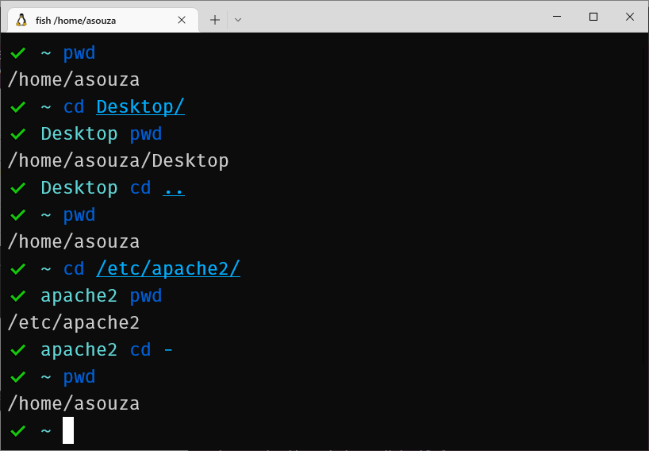
Linux Commands - cd
Simple command used to change the current working directory of your terminal.

Slide 48
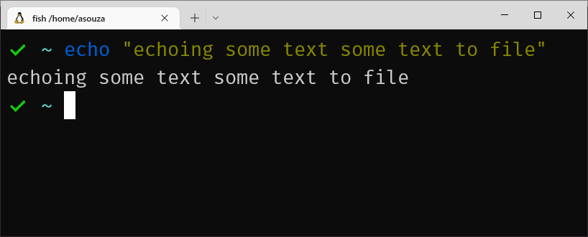
Linux Commands - echo
echo will display a line of text

Slide 49
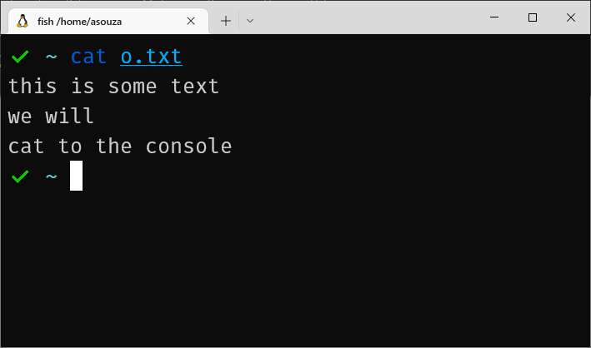
Linux Commands - cat
Cat is used to concatenate files and print them to standard output.

Slide 50
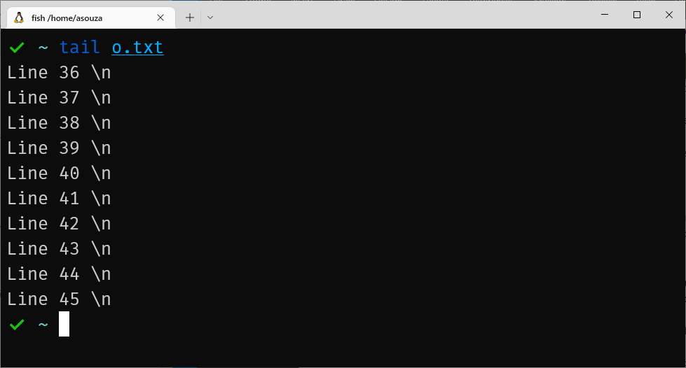
tail – show the last parts of a file

Slide 51
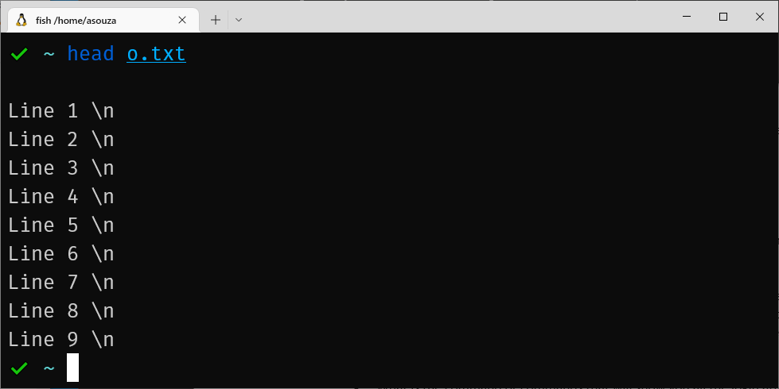
head – show the first parts of a file

Slide 52
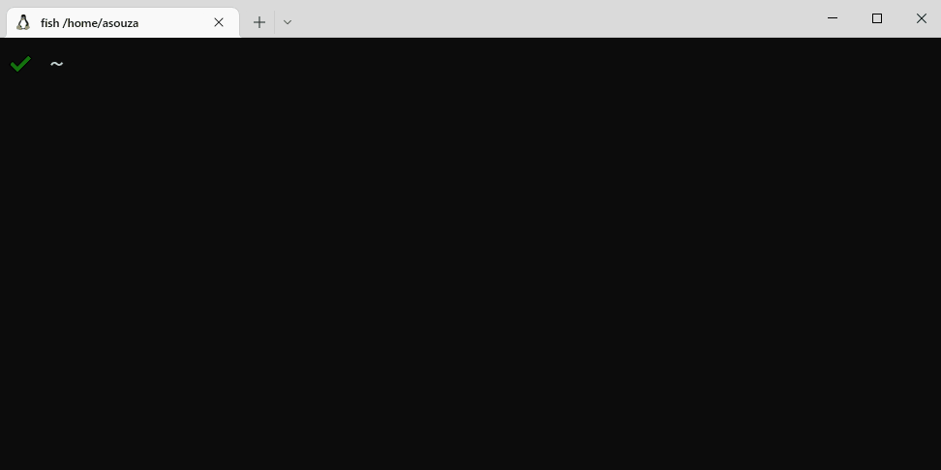
more – scrolling through content one screenful at a time

Slide 53
Linux Commands - less
less is a command like more but has more features.
With less, the entire file is not read in the beginning, this good for large files.
It allows you to scroll forwards and backwards through the file, as well as jump forward and back N lines.
Can also scroll left and right
Can jump to specific line numbers as well
Think of less as more with vim navigation added.

Slide 54
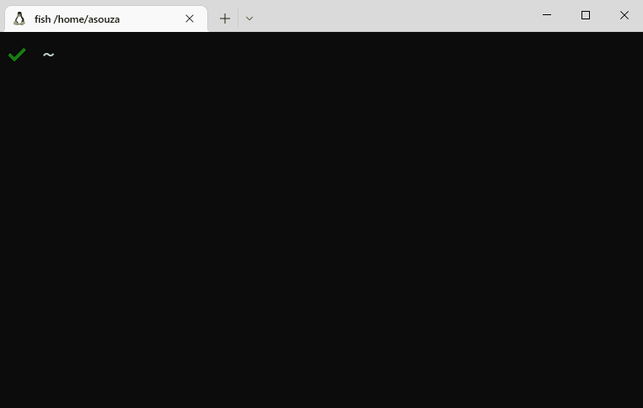
Linux Commands - less

Slide 55
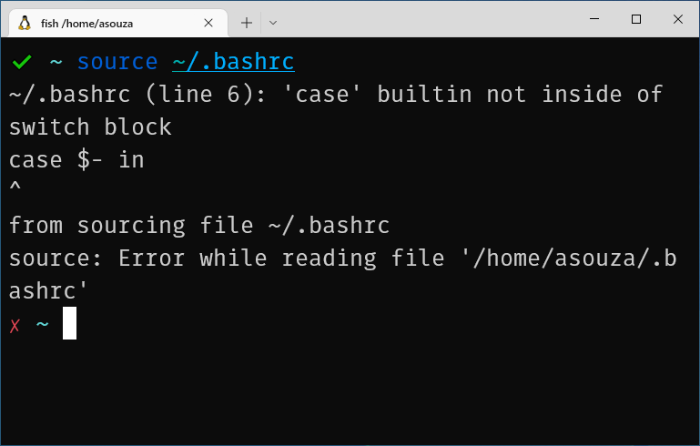
Linux Commands - source

Slide 56
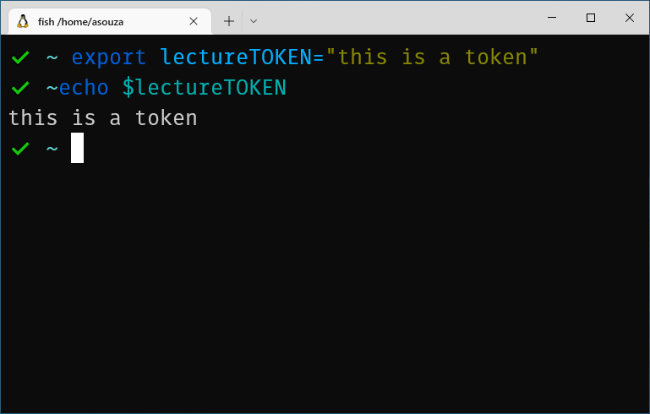
Linux Commands - export

Slide 57
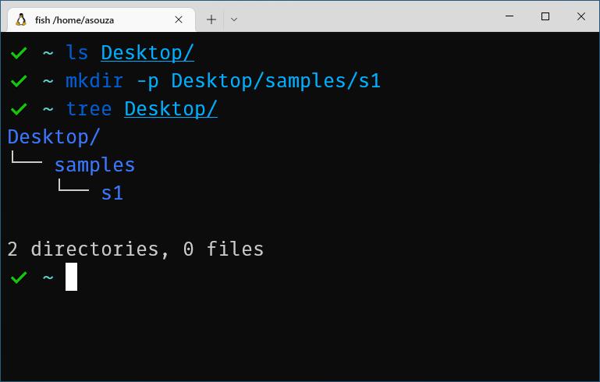
Linux Commands - mkdir

Slide 58
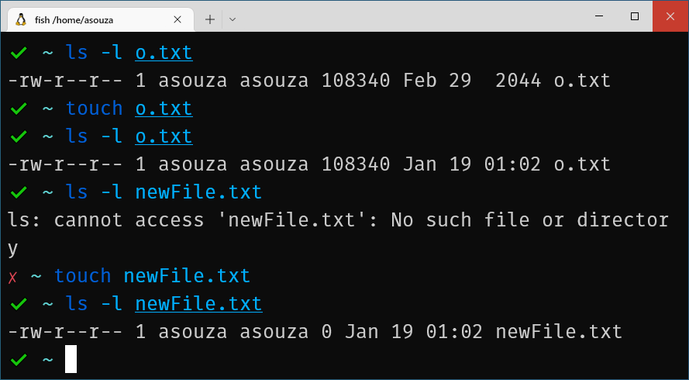
Linux Commands - touch

Slide 59
Linux Commands - rm
Used to remove files.
Can be used to remove directories as well with the –r command.
Or use rmdir but this only works on empty directories.
rm –d will remove empty directories too.
Command is destructive and result cannot be undone.
At least not easily, you could grep the low-level block device looking for fragments of the file.

Slide 60
Linux Commands - cp
cp command is used to copy files and directories.
If you want to copy directories, then the –r command is needed.
If you want permissions to be preserved the –a command is needed.
If you want to copy attributes of a file only BUT not its contents you can use the --attributes-only option

Slide 61
Linux Commands - mv
mv is a command to move files and directories.
No special option is needed to move directories.
If you want mv to not overwrite an existing file, then use the –n option
mv is also used to rename files as well.

Slide 62
Linux Commands - chmod
chmod is used to change file mode bits.
These bits are used to determine the permissions of a file or directory.
Three groups of permissions
(u)ser – user permissions
(g)roup – group permissions
(o)ther – permissions for users not in group or the user owner of the file.
(a)all, used to denote ALL users.
Can use numbers or symbols to set permissions
For example:
chmod 777file would give everyone on the system read, write and execute privileges to the file.
chmod a+rwx file is the equivalent to the above.
chmod a-rwx file would remove all permissions

Slide 63
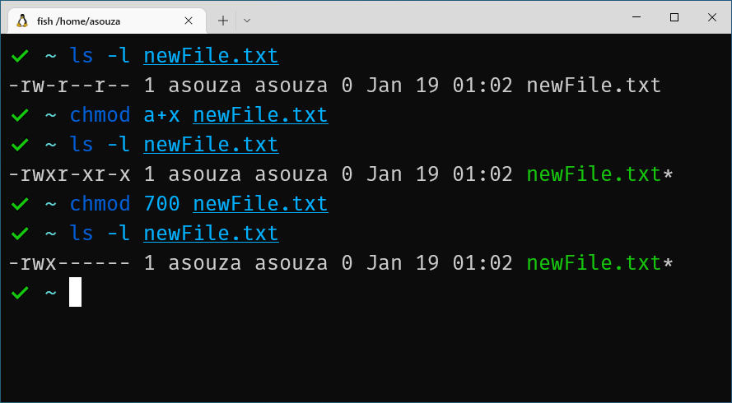
Linux Commands - chmod

Slide 64
Linux Commands - chown
Command use to change filer owner or group owner
Typical syntax is:
chown userowner:groupname file
chown userowner: file change file owner but not group owner
chown :groupname file change group owner but not file owner

Slide 65
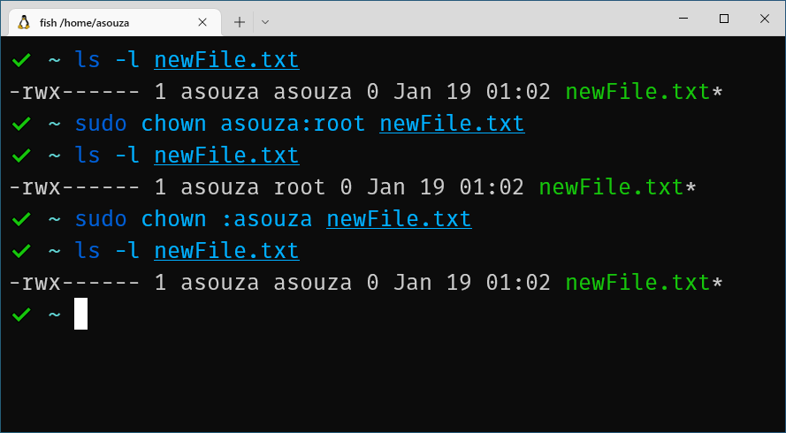
Linux Commands - chown

Slide 66
Linux Commands - file
The file command can be used to determine the file type.
Uses three types of test to determine file types:
Filesystem test
Magic test
Language test
Whichever test succeeds first, that type is shown

Slide 67
Linux Commands - rsync
rsync is a versatile copy command. Remember cp?
most commonly used command for copying and synchronizing files and directories remotely as well as locally in Linux/Unix systems.
Very efficient file copier. Faster than scp (secure copy) because it uses the remote-update protocol which allows rsync to only copy differences between files.
Also supports compression and decompression while transferring files to save bandwidth.
Can also tell rsync which files or a collection of files to exclude from the copy process.

Slide 68
Linux Commands - rsync
rsync does not normally come installed on most Linux distros.
Can be installed on Debian based systems with:
sudo apt –y install rsync
Basic syntax of rsync is:
rsync options source destination
Copy files locally:
rsync –zvh backup412.tar.gz /backups/spring2019
z is for compressing while moving (not important for local copying.)
h is for human readable output
v is verbose mode.

Slide 69
Linux Commands - rsync
Copy or sync files locally:
rsync –avzh /repos/csc317 /backups/fall2019/csc317
The added a option will run rsync in archive mode, copying files recursively and it also preserves symbolic links, file permissions, user & group ownerships and timestamps
When copying repos, files or directories that already exist in the destination path will cause rsync to only copy the changes from the source path.
Copy or sync files from local to remote
rsync –avzh /repos/csc317 ubuntu@ajsouza.com:~/backups/fall2019/csc317
Copy or sync files from remote to local
rsync –avzh ubuntu@ajsouza.com:~/backups/fall2019/csc317 /repos/csc317

Slide 70
Linux Commands - sed
sed (stream editor) is a command for performing all kinds of functions on input streams like, searching, find and replace, insertion or deletion.
Most commonly use for substitution or for finding text and replacing it.
This can be done without opening the file as well.
For example, let's say if our syllabus was a .txt file instead of a pdf, and we wanted to replace all text from ‘Fall 2018’ to ‘Spring 2019’
sed –i ‘s/Fall 2018/Spring 2019/g’ syllabus.txt

Slide 71
Linux Commands - sed
sed –i ‘s/Fall 2018/Spring 2019/g’ syllabus.txt
The -i option will replace test in-place (change contents of syllabus.txt)
The ‘s/find/replace/g’ option defines what to find, what to replace with, and how many to replace.
If you do /1 it will replace the first 1 found, /2 will do the first 2 and so on
If you do /3g, itl will all occurrences from the 3 match and on.
More information can be found here :
https://likegeeks.com/sed-linux/

Slide 72
Linux Commands – awk*
* ➔ awk is not a command but a scripting language used for manipulating data and generating reports.
It can used to print fields in a file using built in variables when running awk.
Some built-ins are:
$0 → whole line
$1 → field 1
$n → field n
FIELDWIDTHS → field width
RS specifies record separator
FS specifies field separator.

Slide 73
Linux Commands – awk* -- Example
For example, say we wanted to print every user and their home directory to the console. WITH pretty format.
We can use the following awk script to do so:
awk 'BEGIN {FS=":";printf "| %-20s | %-20s |\n", "User", "Home Path";n =1; while(n < 48){printf "-";n++;};print}{printf "| %-20s | %-20s |\n", $1, $6} END{n = 1; while(n < 48){printf "-";n++;}printf"\n";}' /etc/passwd

Slide 74
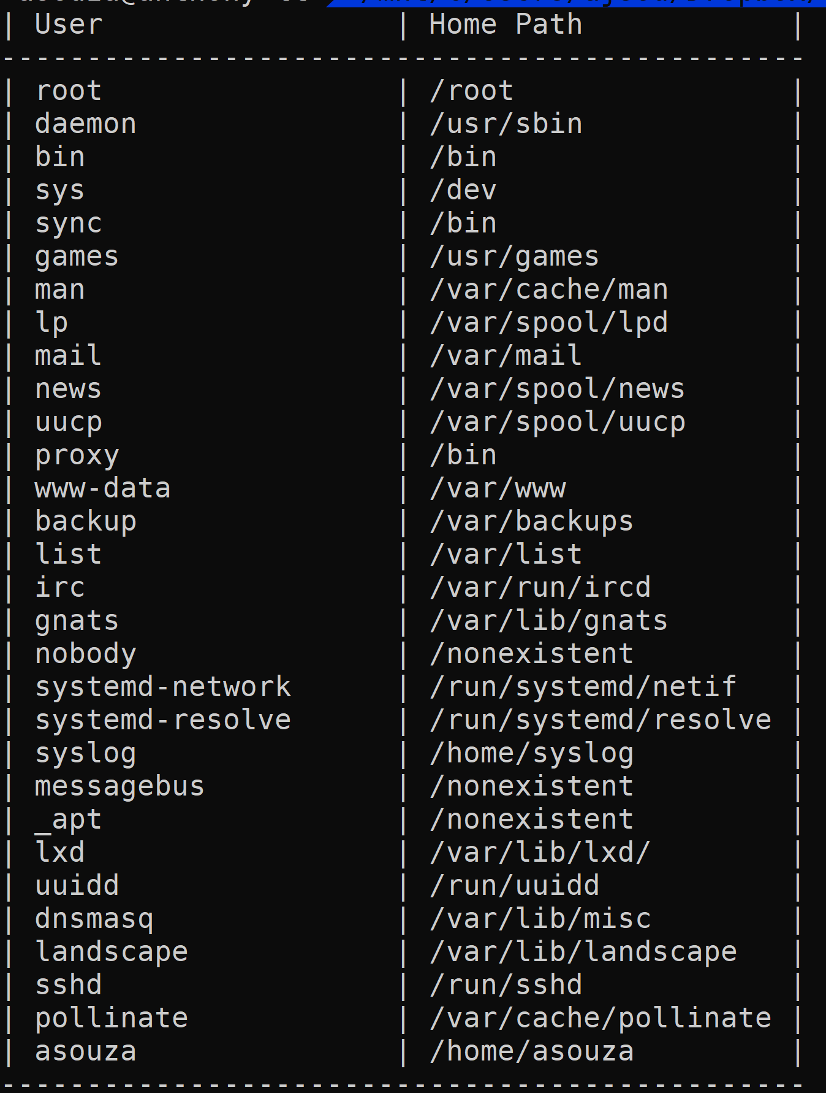
Linux Commands – awk* -- Example
Previous slide produces

Slide 75
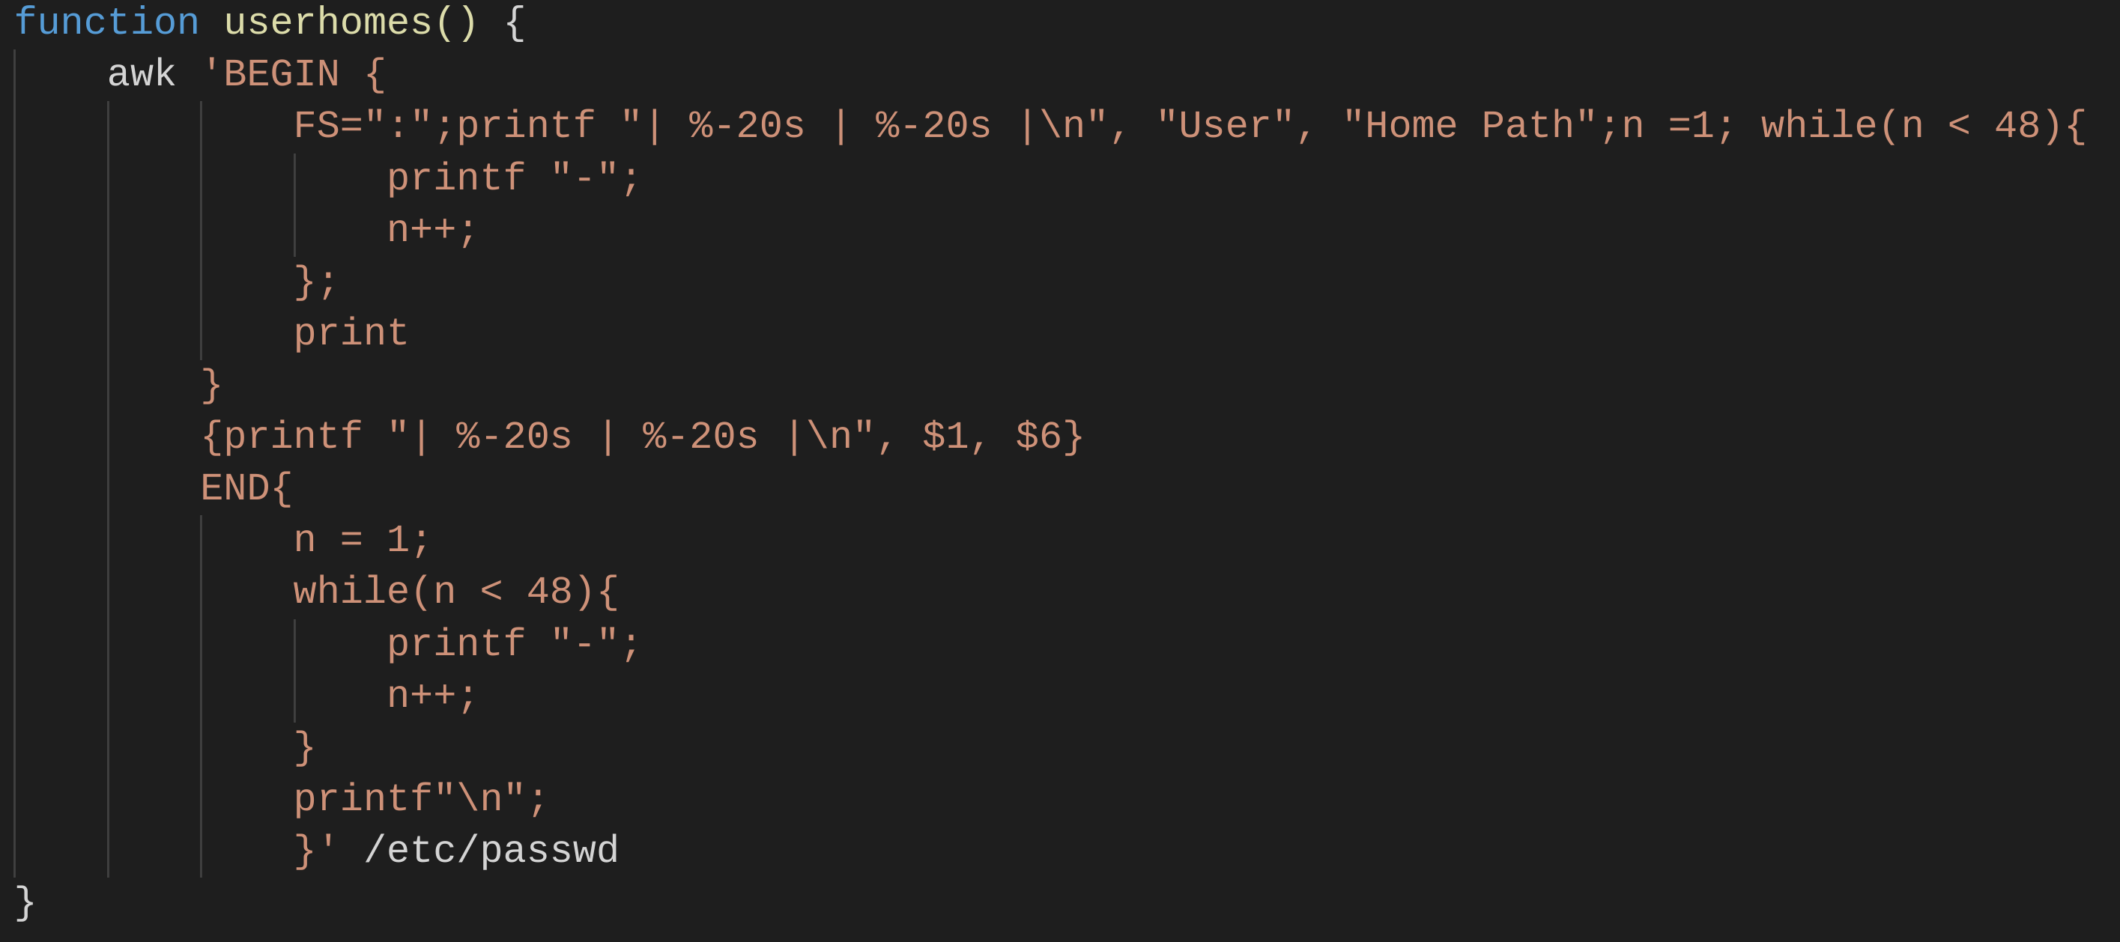
Linux Commands – awk* -- Example
If retyping the previous command is tedious , but needs to be done repeatedly, you can either define it as an alias or a bash function.
A bash function is a better approach.
This can be defined in your .bashrc file

Slide 76
Linux Commands - grep
grep is a command that is used to print lines that match patterns.
Looking for patterns in each file.
“-” given as a file means search standard input
If no file is given the current directory is used.
The -i option can be used to search using patterns that are case insensitive.
If you want to search for words, but exclude when given words appear as substrings of other words, you can use the –w option.

Slide 77
Linux Commands - grep
Say if we want to find all the times a certain use has logged into our server (failed or successful)
sudo grep 'asouza' /var/log/auth.log | grep "session“
The above command looks in the auth.log file for log in attempts by asouza and filters that output looking for newly created sessions.
Grep is a powerful command line tool for digging through log files looking for lines of text that are important and then can pass this output to other commands who can further process the output.

Slide 78
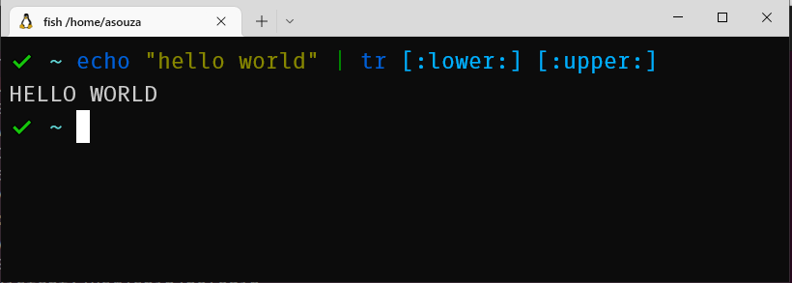
Linux Commands - tr
tr – a Linux command to translate or delete characters.
For example, if we wanted to convert all characters to upper case letters, we can do the following

Slide 79
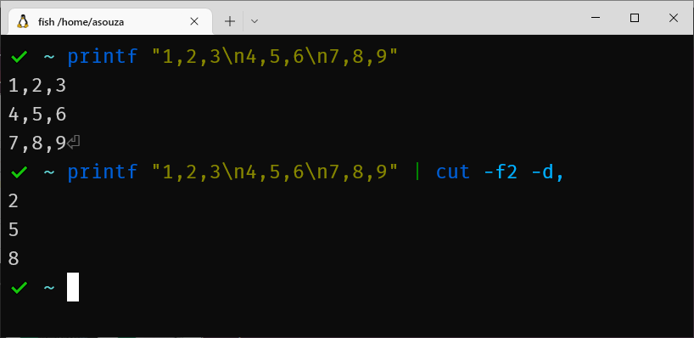
Linux Commands - cut
cut – a Linux command to remove sections from each line in a file.

Slide 80
Linux Commands - find
Searches for files in the file system.
It can search the entire file system or from a starting point you give.
For example if we want to find all C source files in all the csc415 repositories, we can do the following:
find /cac415/repos/ -name “*.c”
*.c means match any set of characters appearing before .c, we only care if the file ends in .c

Slide 81
Linux Commands - find
Then with the output of the find command we can do other commands
find /cac415/repos/ -name “*.c” | xargs –I{} cp {} /csc415/visualinspect/
xargs will be discussed next but it allows us to execute commands with an output from another command.
The –I{} is used because xargs puts the string only at the end of the command but for our cp command we want it second to last.
{} we be a replacement string and the list of files from find we put the first argument of cp and not the second, which is the default behavior of xargs.

Slide 82
Linux Commands - xargs
xargs is a command which can be used to build and execute commands from standard input
some commands accept arguments, this is where xargs can be useful.
For example, say if we want to remove certain files that were found using the find Linux command.
We can use find to find all files that are c source files:
find . –name “*.c”
The output of the above command will be all files ending in .c

Slide 83
Linux Commands - xargs
Now if we want to remove all these files, we can send this output to xargs which then can execute rm on each file in the output.
find . –name “*.c” | xargs –p rm -rf
The output of find will be piped to xargs, then for all the files in the output, xargs will execute rm –rf on the files.
The –p option will make xargs interactive asking if you want to execute the command.
Say we want to find all C or C++ source files that use the pthread library:
find . -name "*.c*" | xargs grep 'pthread.h'

Slide 84
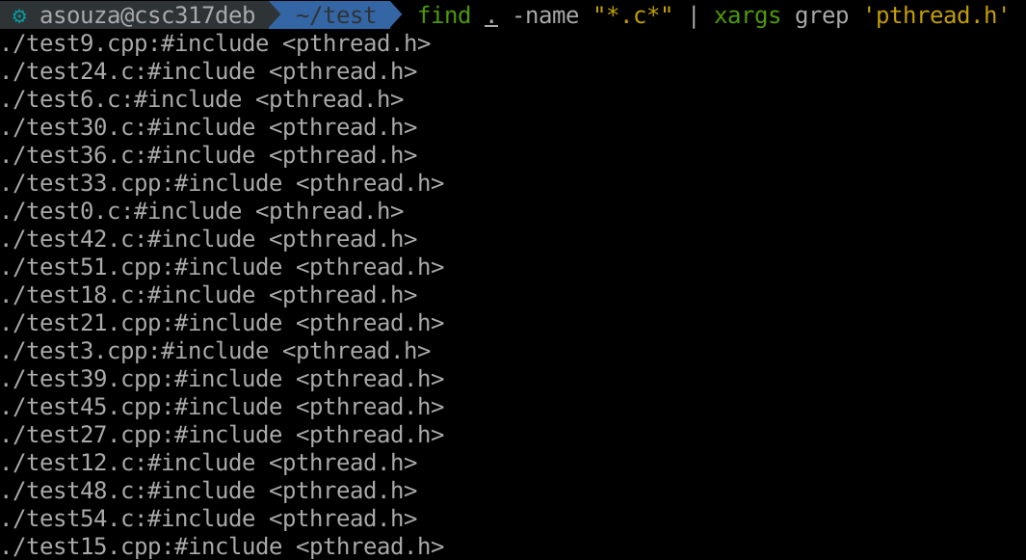
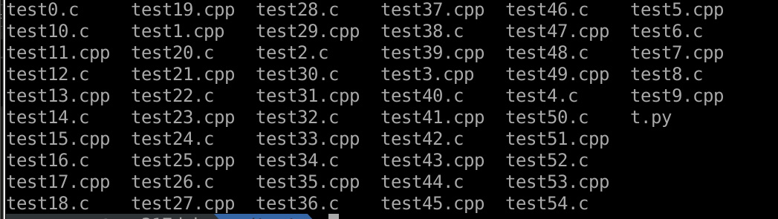
Linux Commands – xargs – sample output

Slide 85
Linux Commands - adduser
Used to add a user to your Linux OS
Do not confuse with useradd which is a low-level utility and adduser should be used instead
adduser will create a home directory from the /etc/skel directory.
If you wanted a specific type of file structure for your users, you would change this.
You can add users to groups with the –G option
A command called addgroup can be used to add user groups.
How users are added is defined in /etc/adduser.conf

Slide 86
Linux Commands - deluser
Used to delete a user to your Linux OS
Do not confuse with userdel which is a low-level utility and deluser should be used instead
When removing users you can specific if their home directories can be deleted as well.
A command called delgroup can be used to add user groups.
How users are removed is defined in /etc/deluser.conf

Slide 87
Linux Commands - uname
Command used to print system information.
--all or –a command is used to print all information.
uname –s will print kernel name.
uname –v will print kernel version.
uname –r will print kernel release.

Slide 88
Linux Commands - service
service command is used to run an init script.
This is a script used to manage a system service.
More service scripts with have a name similar to or the same as the service the manage.
For example, NGINX, a webserver that is ran as a service.
Its init script has the following management options:
Force-reload
Reload
restarted
Start
Stop
status

Slide 89
Linux Commands - curl
curl is a command line tool to transfer data to or from a server.
Data transfer can be done over the following supported protocols:
HTTP, FTP, IMAP, POP3, SCP, SFTP, SMTP, TFTP, TELNET, LDAP or FILE
This tool is preferred for automation, since it is designed to work without user interaction.
Great way to quickly test APIs. POSTMAN is another a good option as well but requires more setup.
We may discuss postman later.
Curl is a command that is not always installed by default, it will need to be installed with sudo apt –y install curl

Slide 90
Linux Commands - curl
curl –o url_to_file
Download a file with curl
curl –o filename url_to_file
Download a file with curl with the given filename
You can download multiple files at once with multiple pairs of:
–o URL
curl –I URL
Used to request HTTP headers from a given URL
Headers allow the remote web server to send additional information about itself along with the actual request. Helps users know how the request is being handled.

Slide 91
Linux Commands - curl
curl --data “categoryID=5&itemName=Apple&price=3.99” URL
Used to send data so server via POST.
Not always necessary to include the HTTP verb POST or get sometimes it can be inferred.
-X option can be used to be explicit, but it is used for custom HTTP verbs.
Curl will send POST as URL encoded, i.e., it’s added the URL itself.
If you want to send, say JSON data then you need to modify the ContentType Header to specific this.
Default is application/x-www-form-urlencoded

Slide 92
Linux Commands - curl
For example, we can test a login URL with the following curl command:
curl –X POST –H “Content-Type: application/json” –d ‘{“username”=“test”,”passwd”=“test123”}’ https://ajsouza.com/usrmgnt/login
With the above command you can inspect the response to see if the URL correctly logs the user in or shows an appropriate error message.
Later if time permits, we will discus Postman which makes this process a little easier.

Slide 93
Linux Commands - wget
Wget is used as a non-interactive network download.
Think of it as way to download files via the command.
Not default installed on all distros.

Slide 94
Linux Commands - ping
Used to send a special type of data-gram to a host.
Called ICMP ECHO_REQUEST
Great way to see if a host is reachable
Note that not all servers allow ping.
By default AWS(Amazon Web Services) disallows pings.

Slide 95
Linux Commands - iptables
Iptables is a Linux command line firewall that allows system administrators to manage incoming and outgoing traffic via a set of configurable table rules.
This is a great tool to help protect server. However it is a tool that can have complicated commands.
Iptables uses a set of tables which have chains that contain set of built-in or user defined rules.

Slide 96
Linux Commands - iptables
There are 3 types of chains:
Input - This chain is used to control the behavior for incoming connections
Forward - This chain is used for incoming connections that aren’t actually being delivered locally.
Think of a network router. After traffic is received by the router it is redirected to the correct machine on the network, however, the data is rarely ever meant to be sent to the router as a destination.
Output - This chain is used for outgoing connections.

Slide 97
Linux Commands - iptables
Connection Responses:
Accept – Allows the connection
Drop – drops the connection as if it never happened
When you have a drop action, the user trying to access the IP will get a request timeout message, usually.
Reject – blocks the connection but also sends back an error.
When you have the reject action, the user gets a Destination unreachable response.

Slide 98
Linux Commands - iptables
Block all connections from an IP:
iptables –A INPUT –s 9.9.9.9 –j DROP
-A appends a rule
-s is source, the ip to data is coming from.
Block connections from an IP range:
iptables –A INPUT –s 9.9.9.0/24 –j DROP
this will block connections for IPs between 9.9.9.0 to 9.9.9.255
Unblock connection from an IP
iptables –D INPUT –s 9.9.9.9 –j DROP

Slide 99
Linux Commands - iptables
These rules will need to be saved so they will remain after the iptables service is restarted:
sudo /sbin/iptables-save
sudo iptables –L
Lost all current rules for all 3 chains.
Sudo iptables –F
Will flush all currently configured rules.

Slide 100
Linux Commands - ufw
ufw (uncomplicated firewall) is a Linux command that makes iptables easier.
It is implemented on top of iptables to make managing firewall rules easier.
Most likely, it will need to be installed.
sudo apt –y install ufw

Slide 101
Linux Commands - ufw
Here are some simple commands:
sudo ufw allow ssh
sudo iptables -A INPUT -p tcp --dport 22 -j ACCEPT
sudo ufw allow http
sudo iptables -A INPUT -p tcp --dport 80 -j ACCEPT
sudo ufw allow https
sudo iptables -A INPUT -p tcp --dport 443 -j ACCEPT
sudo ufw deny from 9.9.9.0/24
iptables –A INPUT –s 9.9.9.0/24 –j DROP
Note that after ufw is installed it is not enabled. Run the command sudo ufw enable to start the firewall.

Slide 102
Linux Commands - which
Simple Linux command locate a command.
If you need to know where a command resides in the filesystem use which.
For example
which bash returns /usr/bin/bash
The command where is can be used to locate the binary, source, and man pages files for a given command
For example:
whereis bash returns bash: /usr/bin/bash /etc/bash.bashrc /usr/share/man/man1/bash.1.gz

Slide 103
Linux Commands - sudo
sudo is a command used to execute a command as another user.
By default it allows you to execute commands a super user.
But you can also execute commands as another normal user as well.
Useful if you want the command to use that specific user’s configuration files.
You can use the –U option to run a command as a different use.
Another command, su, allows you to substitute a user.
For example, if you want to login as root, you can use su root, if you have the permission it will allow you to login as root without logging out of your current user.

Slide 104
Linux Commands - lsblk
lsblk is used to list block devices on Linux.
These are any device that Linux deems a block device:
Think of devices like Hard drives, USB drives, etc.
lsblk –a
Show all block devices even the empty ones.
lsblk –m
Displays information about each block device showing owner, group mode, name and size.

Slide 105
Linux Commands – df(disk free)
The df Linux command reposts file system disk space usage
df looks at disk used blocks directly in filesystem metadata, so it reports the space used by the file system.
For example : df –h
Filesystem Size Used Avail Use% Mounted on
udev 2.0G 0 2.0G 0% /dev
tmpfs 395M 5.8M 389M 2% /run
/dev/sda1 29G 26G 1023M 97% /
tmpfs 2.0G 0 2.0G 0% /dev/shm
tmpfs 5.0M 4.0K 5.0M 1% /run/lock
tmpfs 2.0G 0 2.0G 0% /sys/fs/cgroup
tmpfs 395M 12K 395M 1% /run/user/1000

Slide 106
Linux Commands - du
du is a command that Summarize disk usage of the set of FILEs, re‐cursively for directories.
This command is used more than df, because it can show disk usage for each file and recursively for directories.
du –h /var/log/auth.log
Shows the amount of space the auth.log uses.
sudo du –h /var/log
Shows the amount of space the log folder uses as well as its subfolders and files.

Slide 107
Linux Commands - du
sudo du -h /var/log
4.0K /var/log/speech-dispatcher
4.0K /var/log/private
4.0K /var/log/firebird
48K /var/log/lightdm
192K /var/log/apt
36K /var/log/cups
15M /var/log/installer/cdebconf
16M /var/log/installer
4.0K /var/log/hp/tmp
8.0K /var/log/hp
8.0K /var/log/nginx
20M /var/log

Slide 108
Linux Commands - du
du -a /etc/ | sort -n -r | head -n 10
The above command will show the top 10 items that use the most space in the /etc folder.
796K /etc/ssl
772K /etc/ssl/certs
616K /etc/apparmor.d
588K /etc/ssh
552K /etc/ssh/moduli
472K /etc/java-11-openjdk
468K /etc/apparmor.d/abstractions
444K /etc/X11
340K /etc/sane.d
340K /etc/java-11-openjdk/security

Slide 109
Linux Commands - tar
Command used to make archive of files or directories.
Also used to remove files from an archive.
If you want to use the gzip compression you can add the –z flag.
If you want to use the bz2 compression(takes longer but compresses better than gzip) you can add the –j flag.
tar -cvf archivename files to create archive
tar -xvf archivename to remove files

